Slide 1

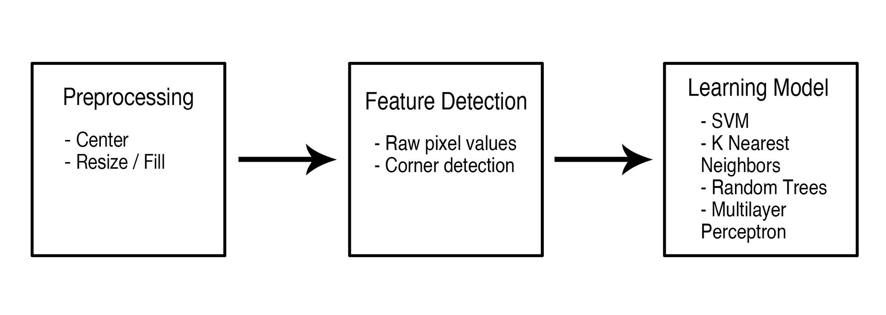


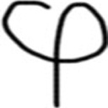
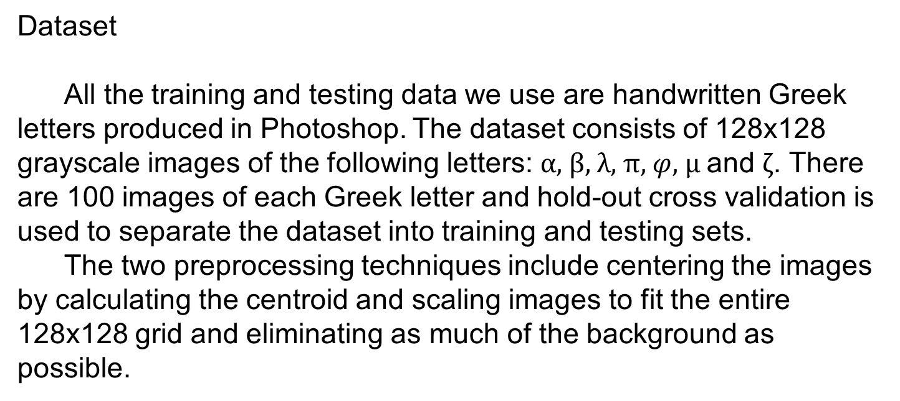
Problem
Typesetting mathematical equations can be an arduous process that often results in nested code that is hard to edit. We attempt to solve this problem by employing machine learning tools to detect handwritten math symbols and output their LaTeX equivalents. Although extensive research has been conducted on handwritten recognition, there is not a consensus on feature extraction. We will test various feature extraction techniques and learning models to find a combination that recognizes math symbols with the lowest error.
Pipeline We run our handwritten symbols through a three-step process in order to produce an optimal output. The first step is to put the image through some form of preprocessing in order to “normalize” the images and reduce variations between inputs. Next, we perform some sort of feature detection algorithm – in our case, either using a vector of pixel values or detected corners in the image. Finally, we input this feature vector into a machine learning algorithm such a support vector machine or a random forest.
Dataset
All the training and testing data we use are handwritten Greek letters produced in Photoshop. The dataset consists of 128x128 grayscale images of the following letters: $α$, $β$, $λ$, $π$, $φ$, $μ$ and $ζ$. There are 100 images of each Greek letter and hold-out cross validation is used to separate the dataset into training and testing sets.
The two preprocessing techniques include centering the images by calculating the centroid and scaling images to fit the entire 128x128 grid and eliminating as much of the background as possible.
Raw Data
Centered
Resized

